Slide 1











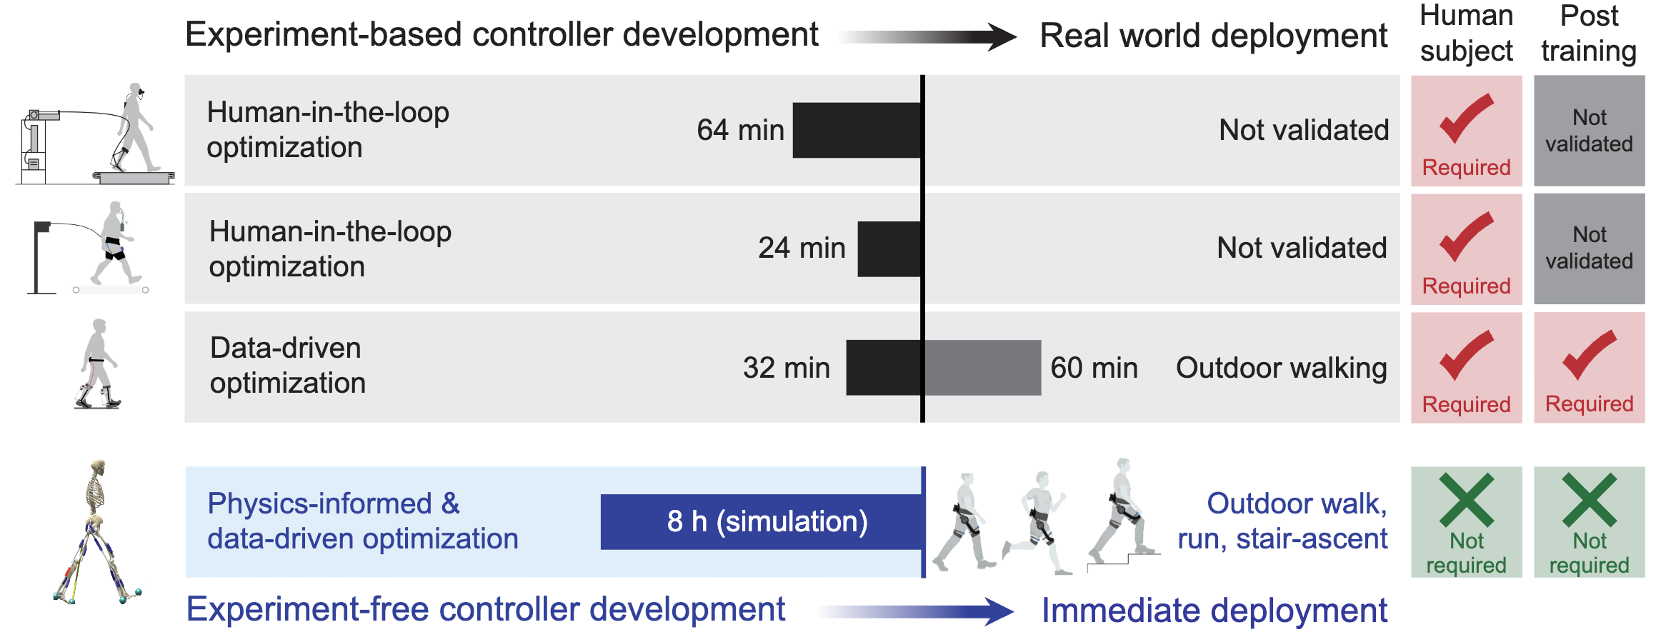
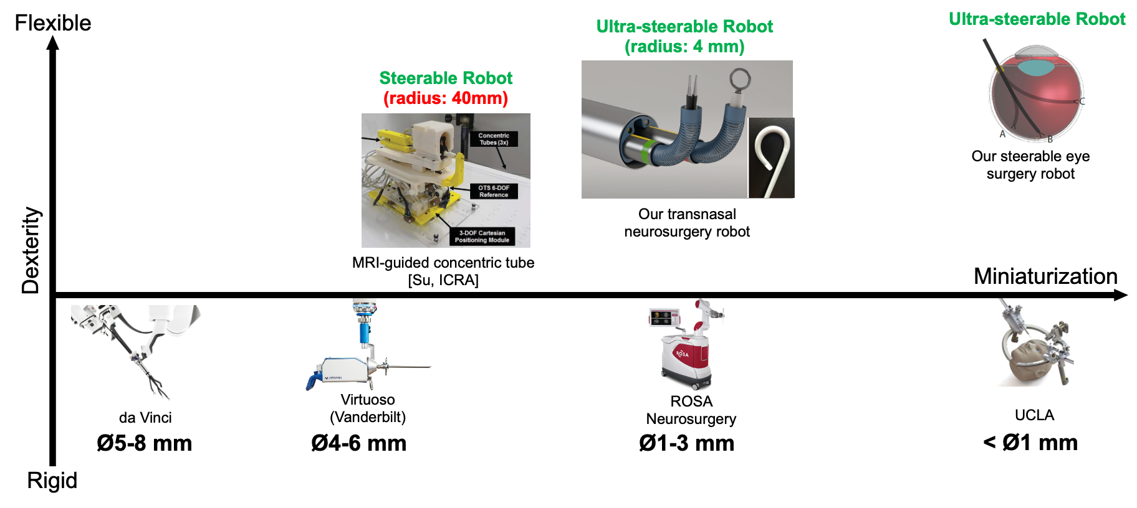
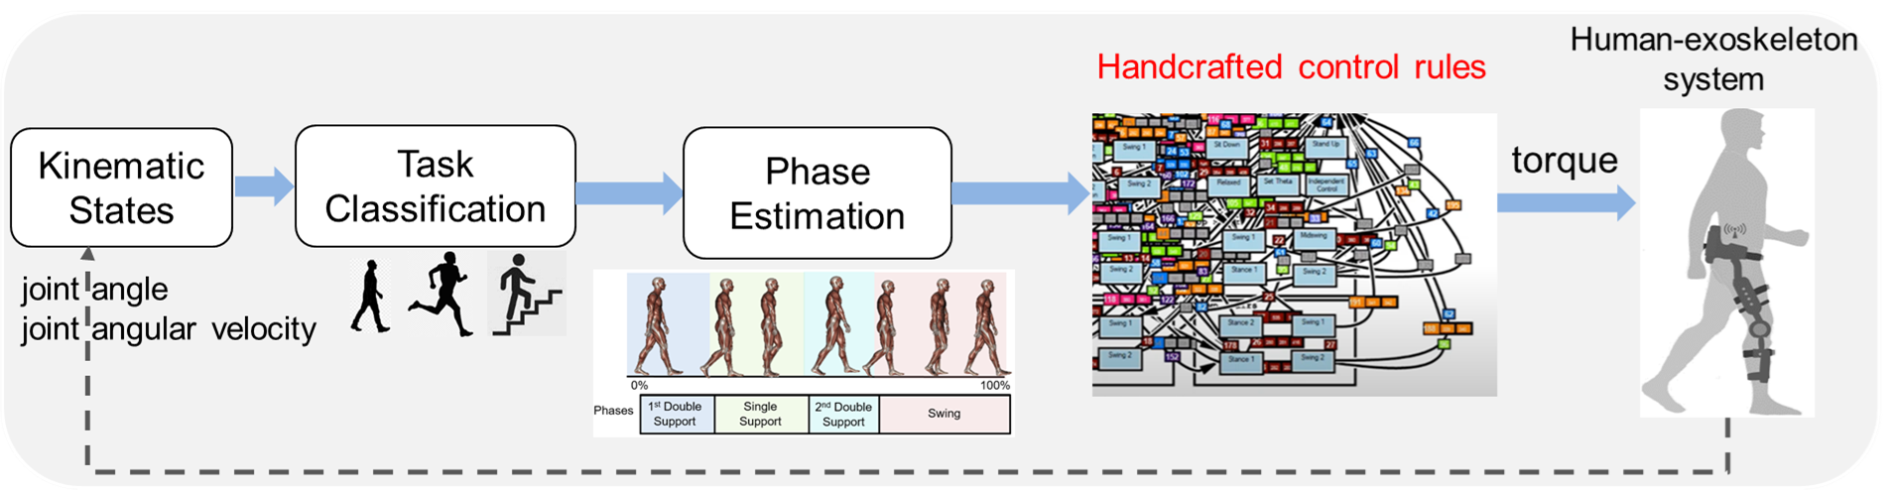
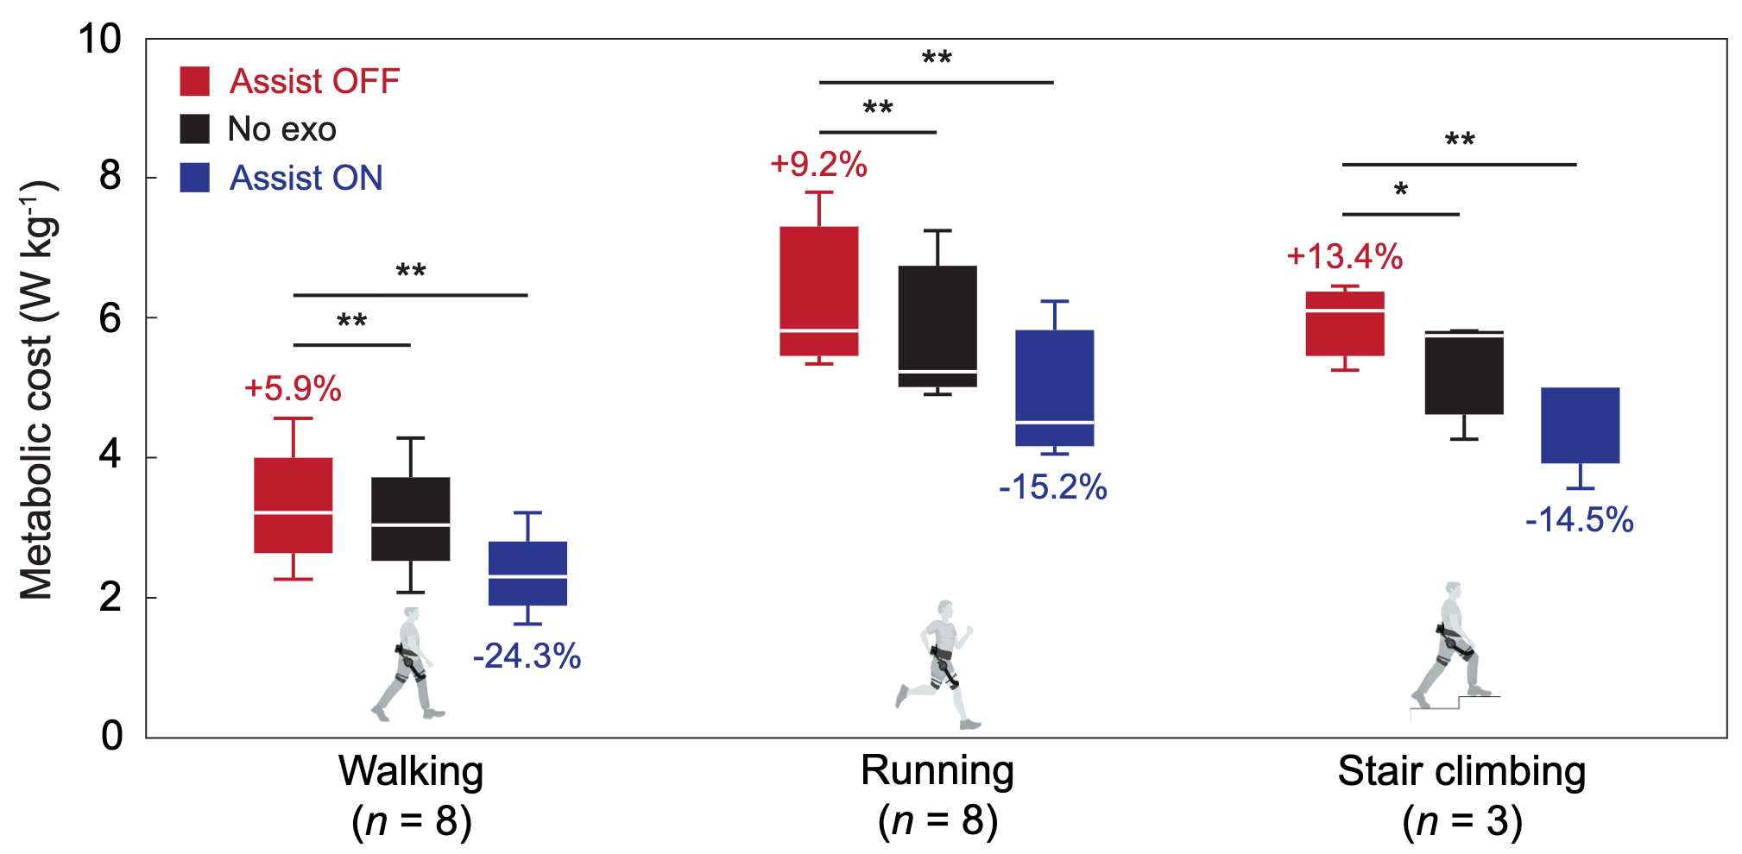
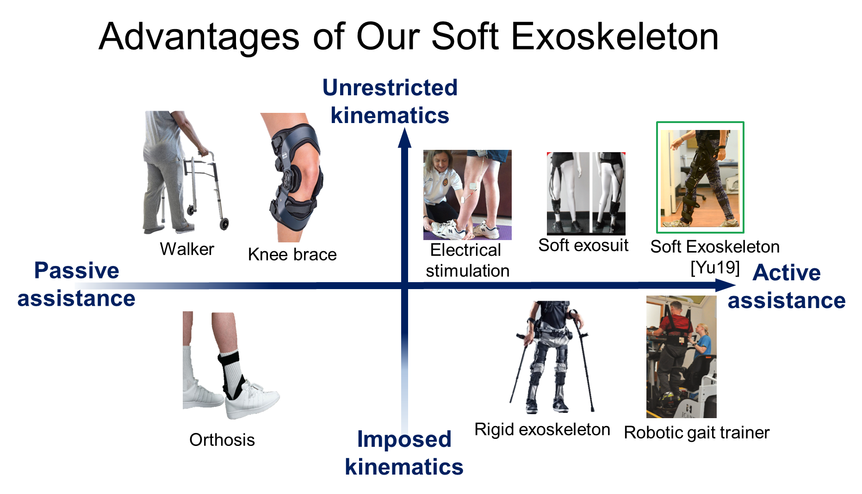
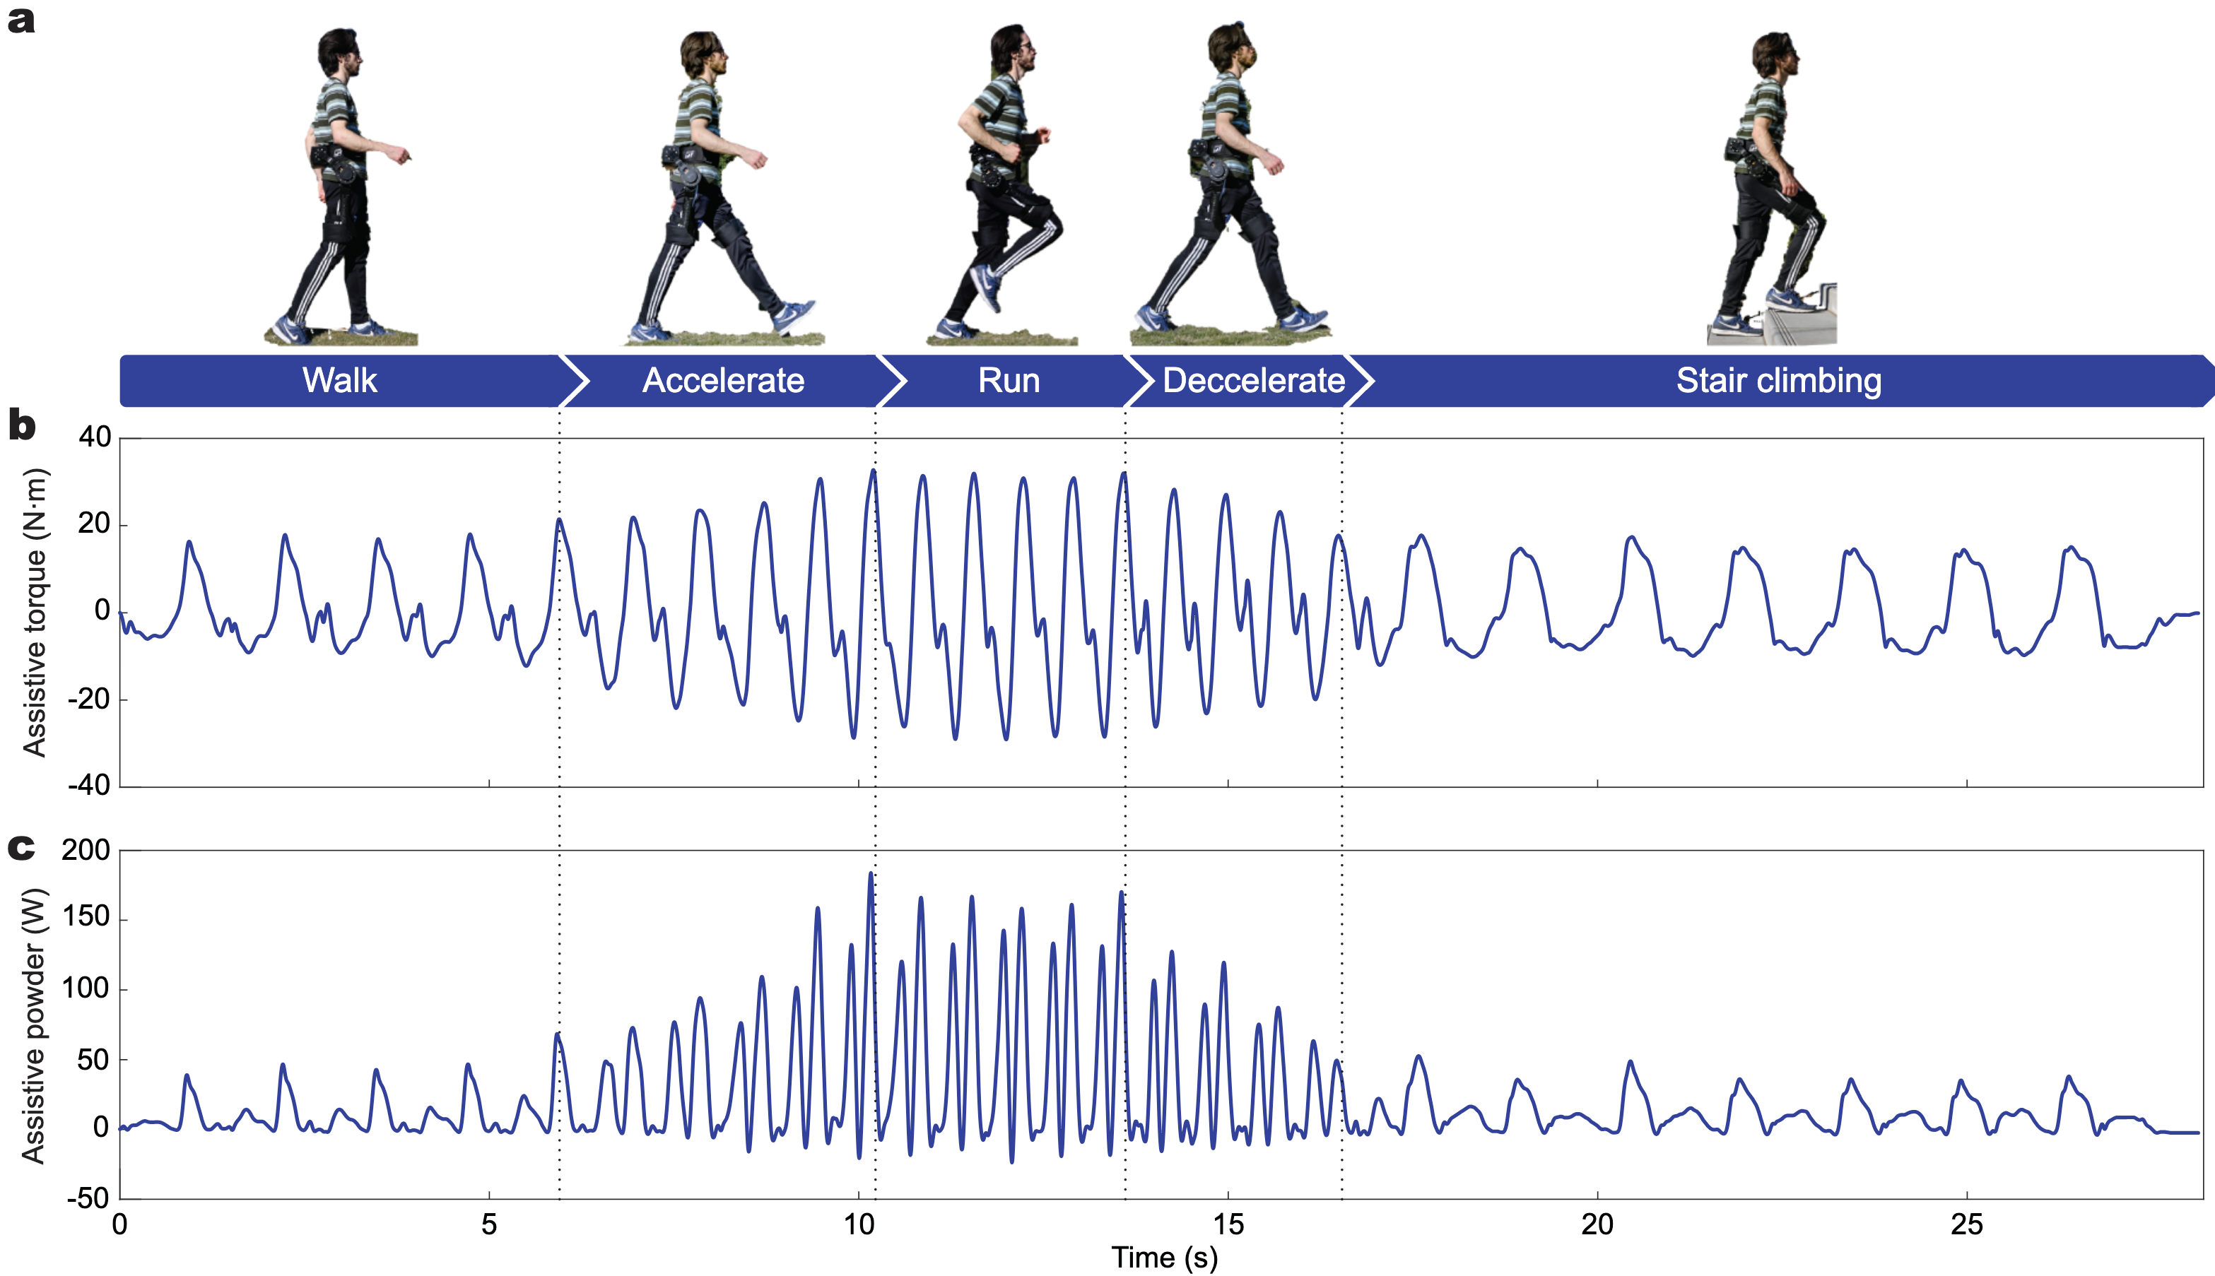
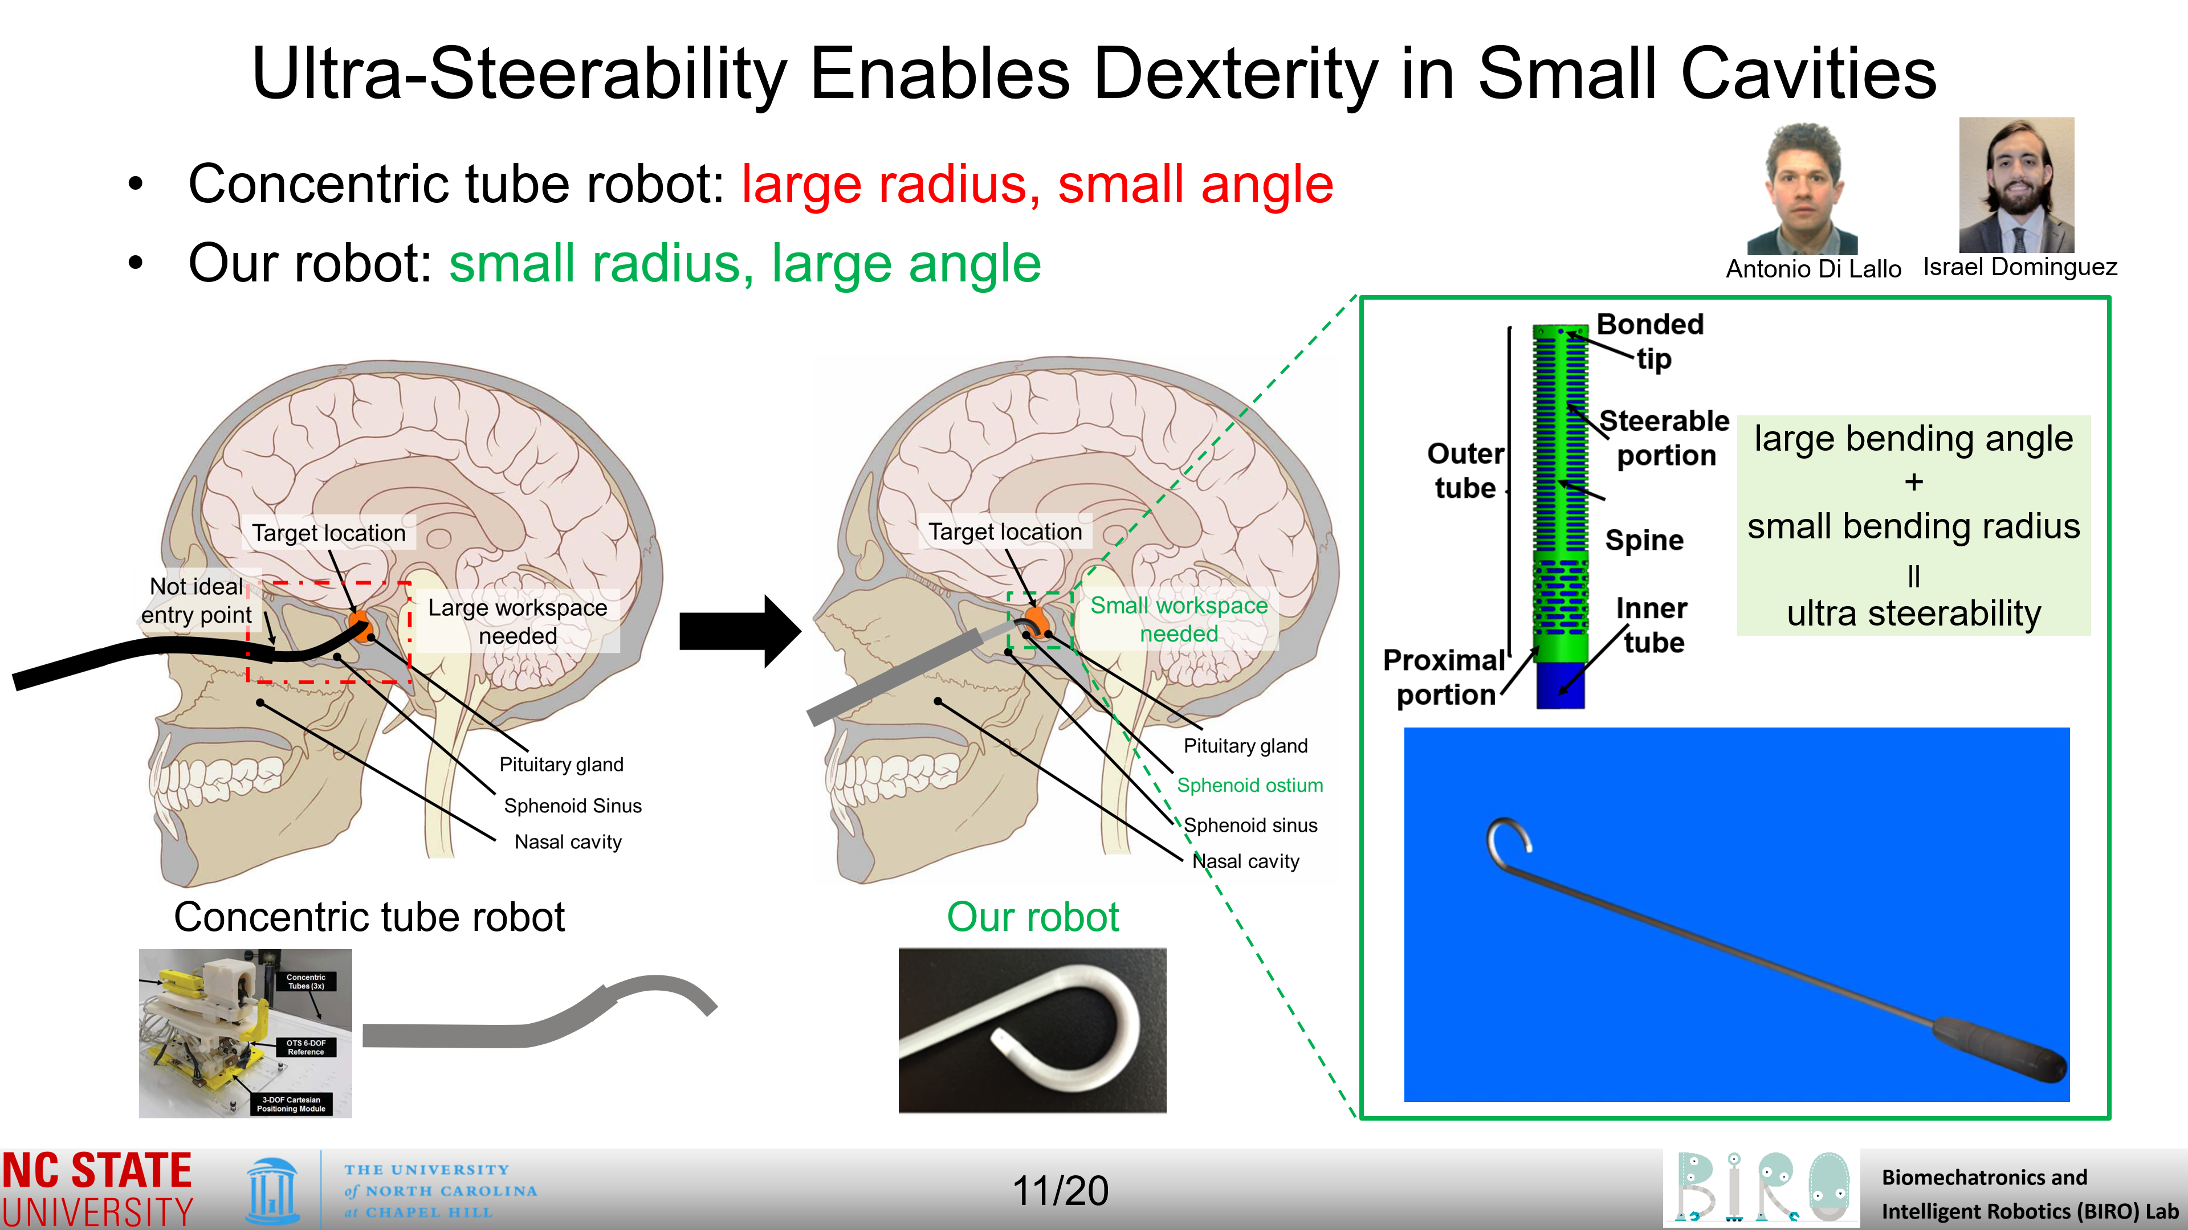
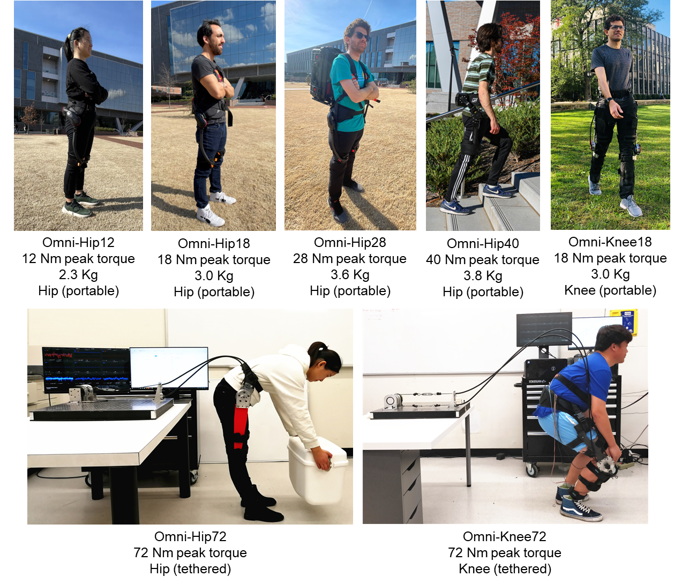
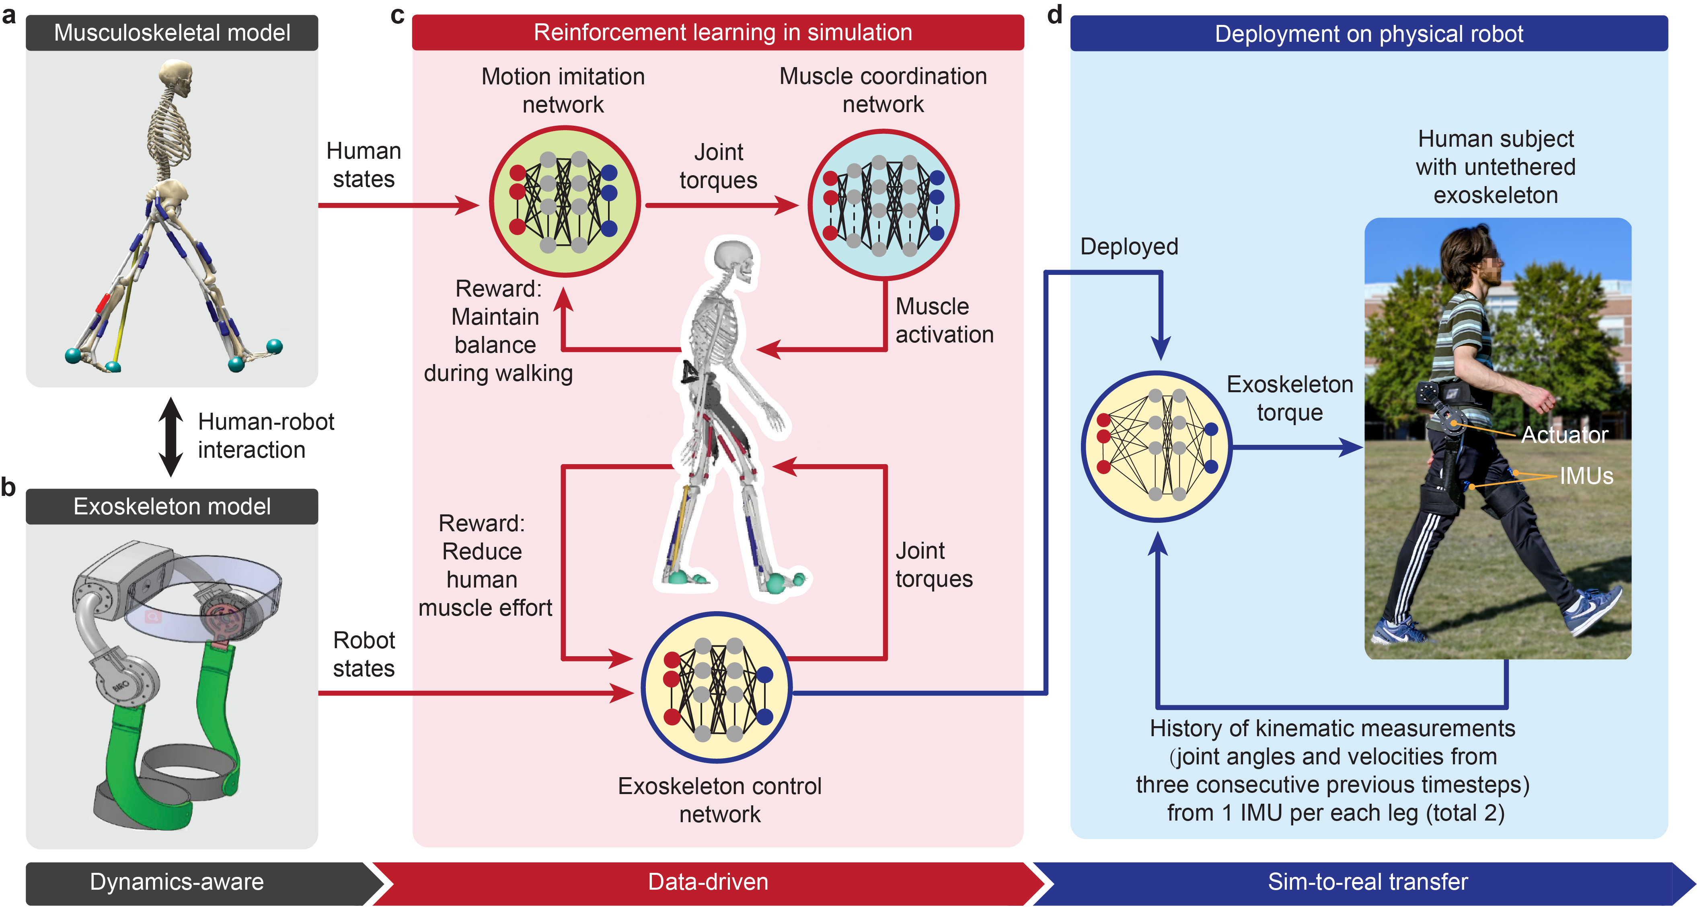

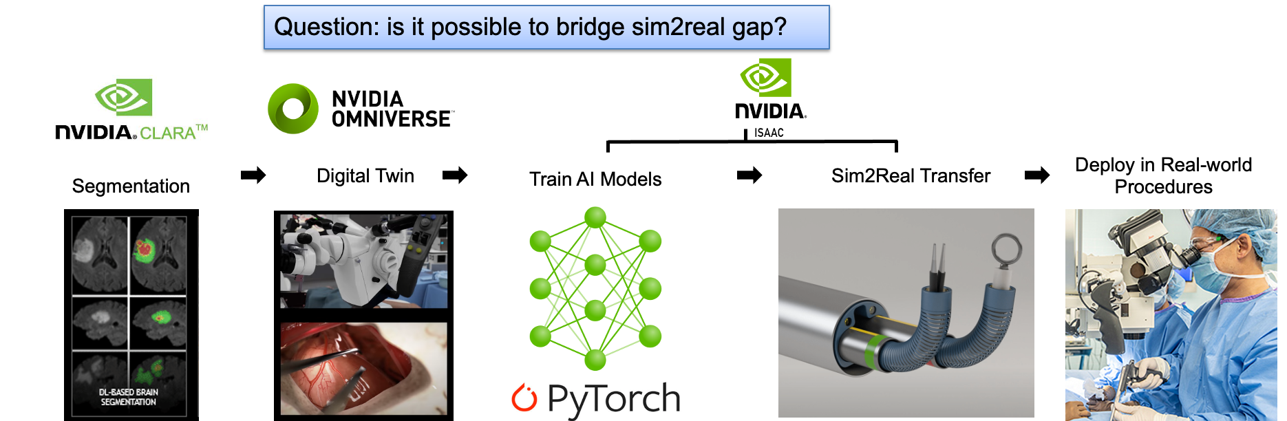
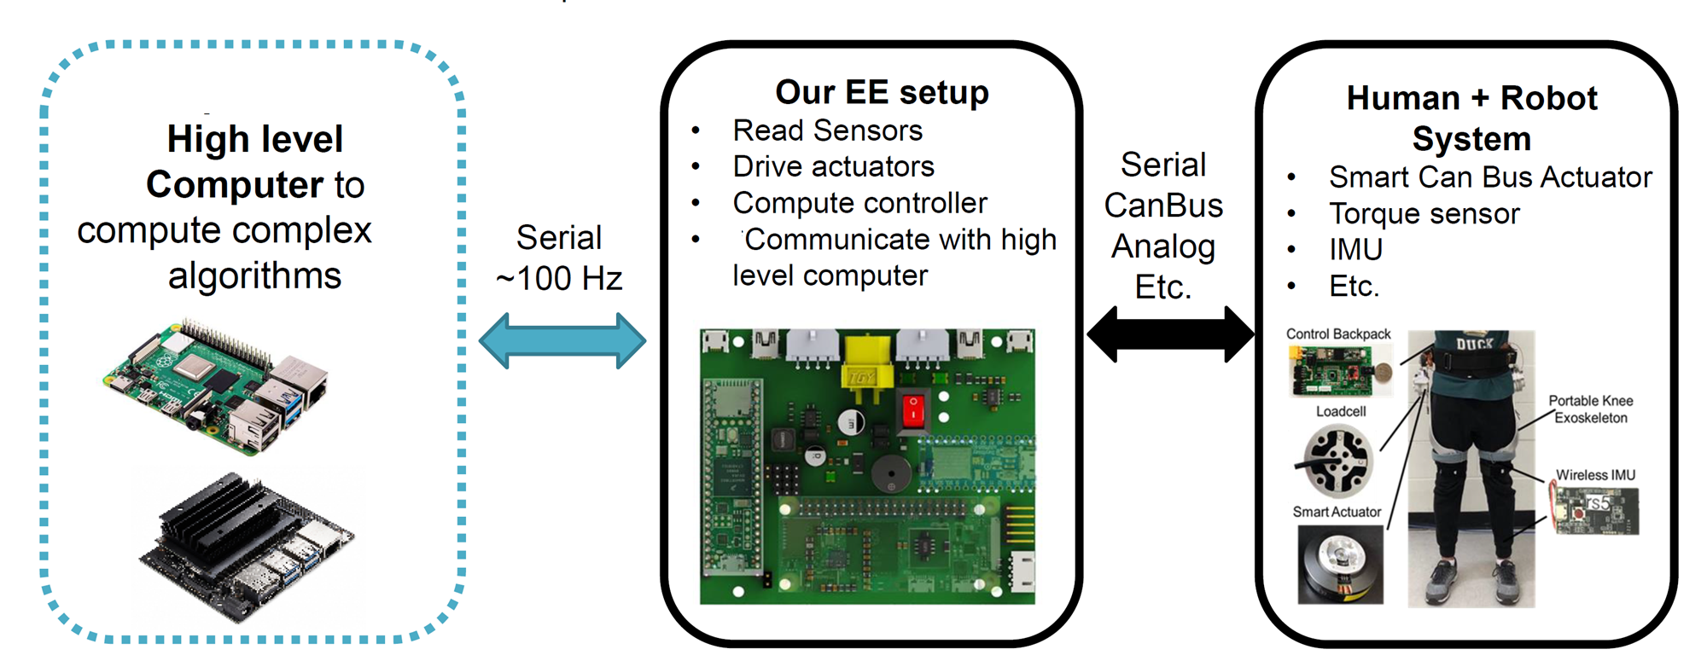
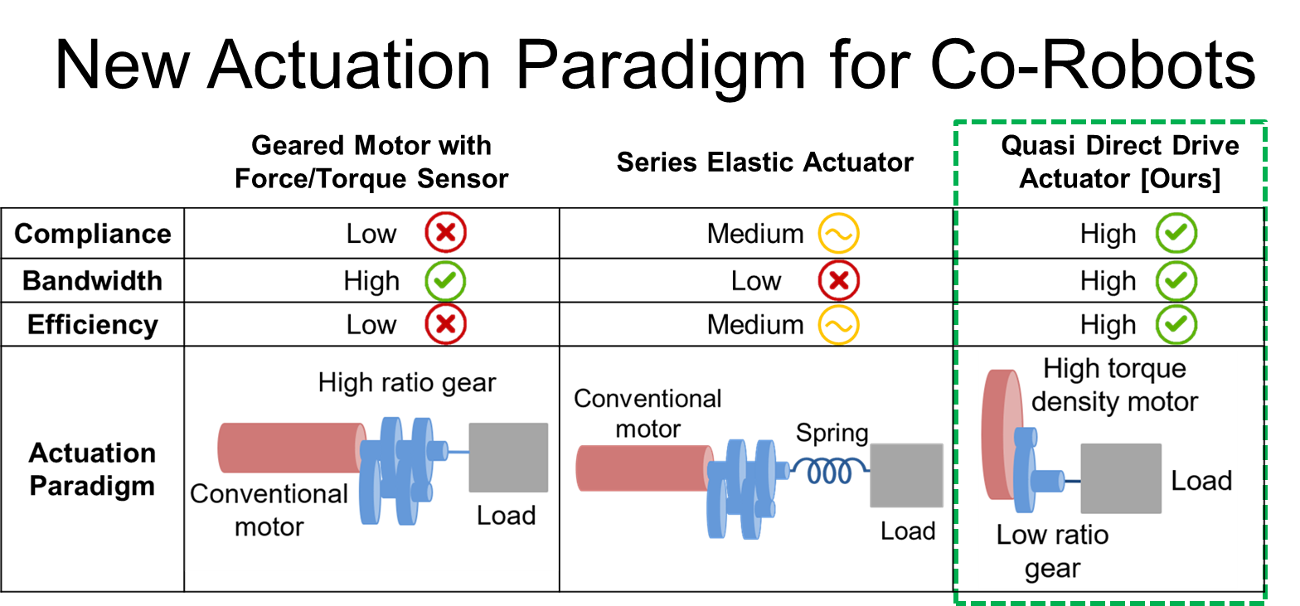
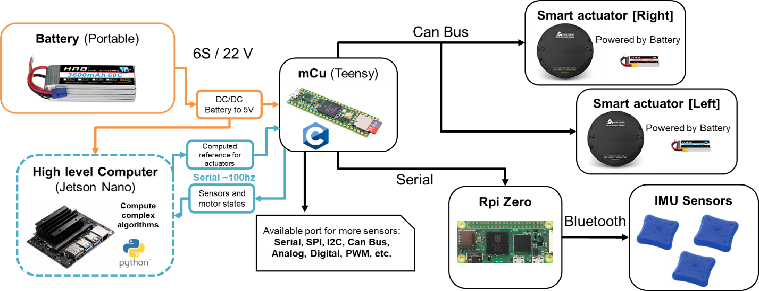
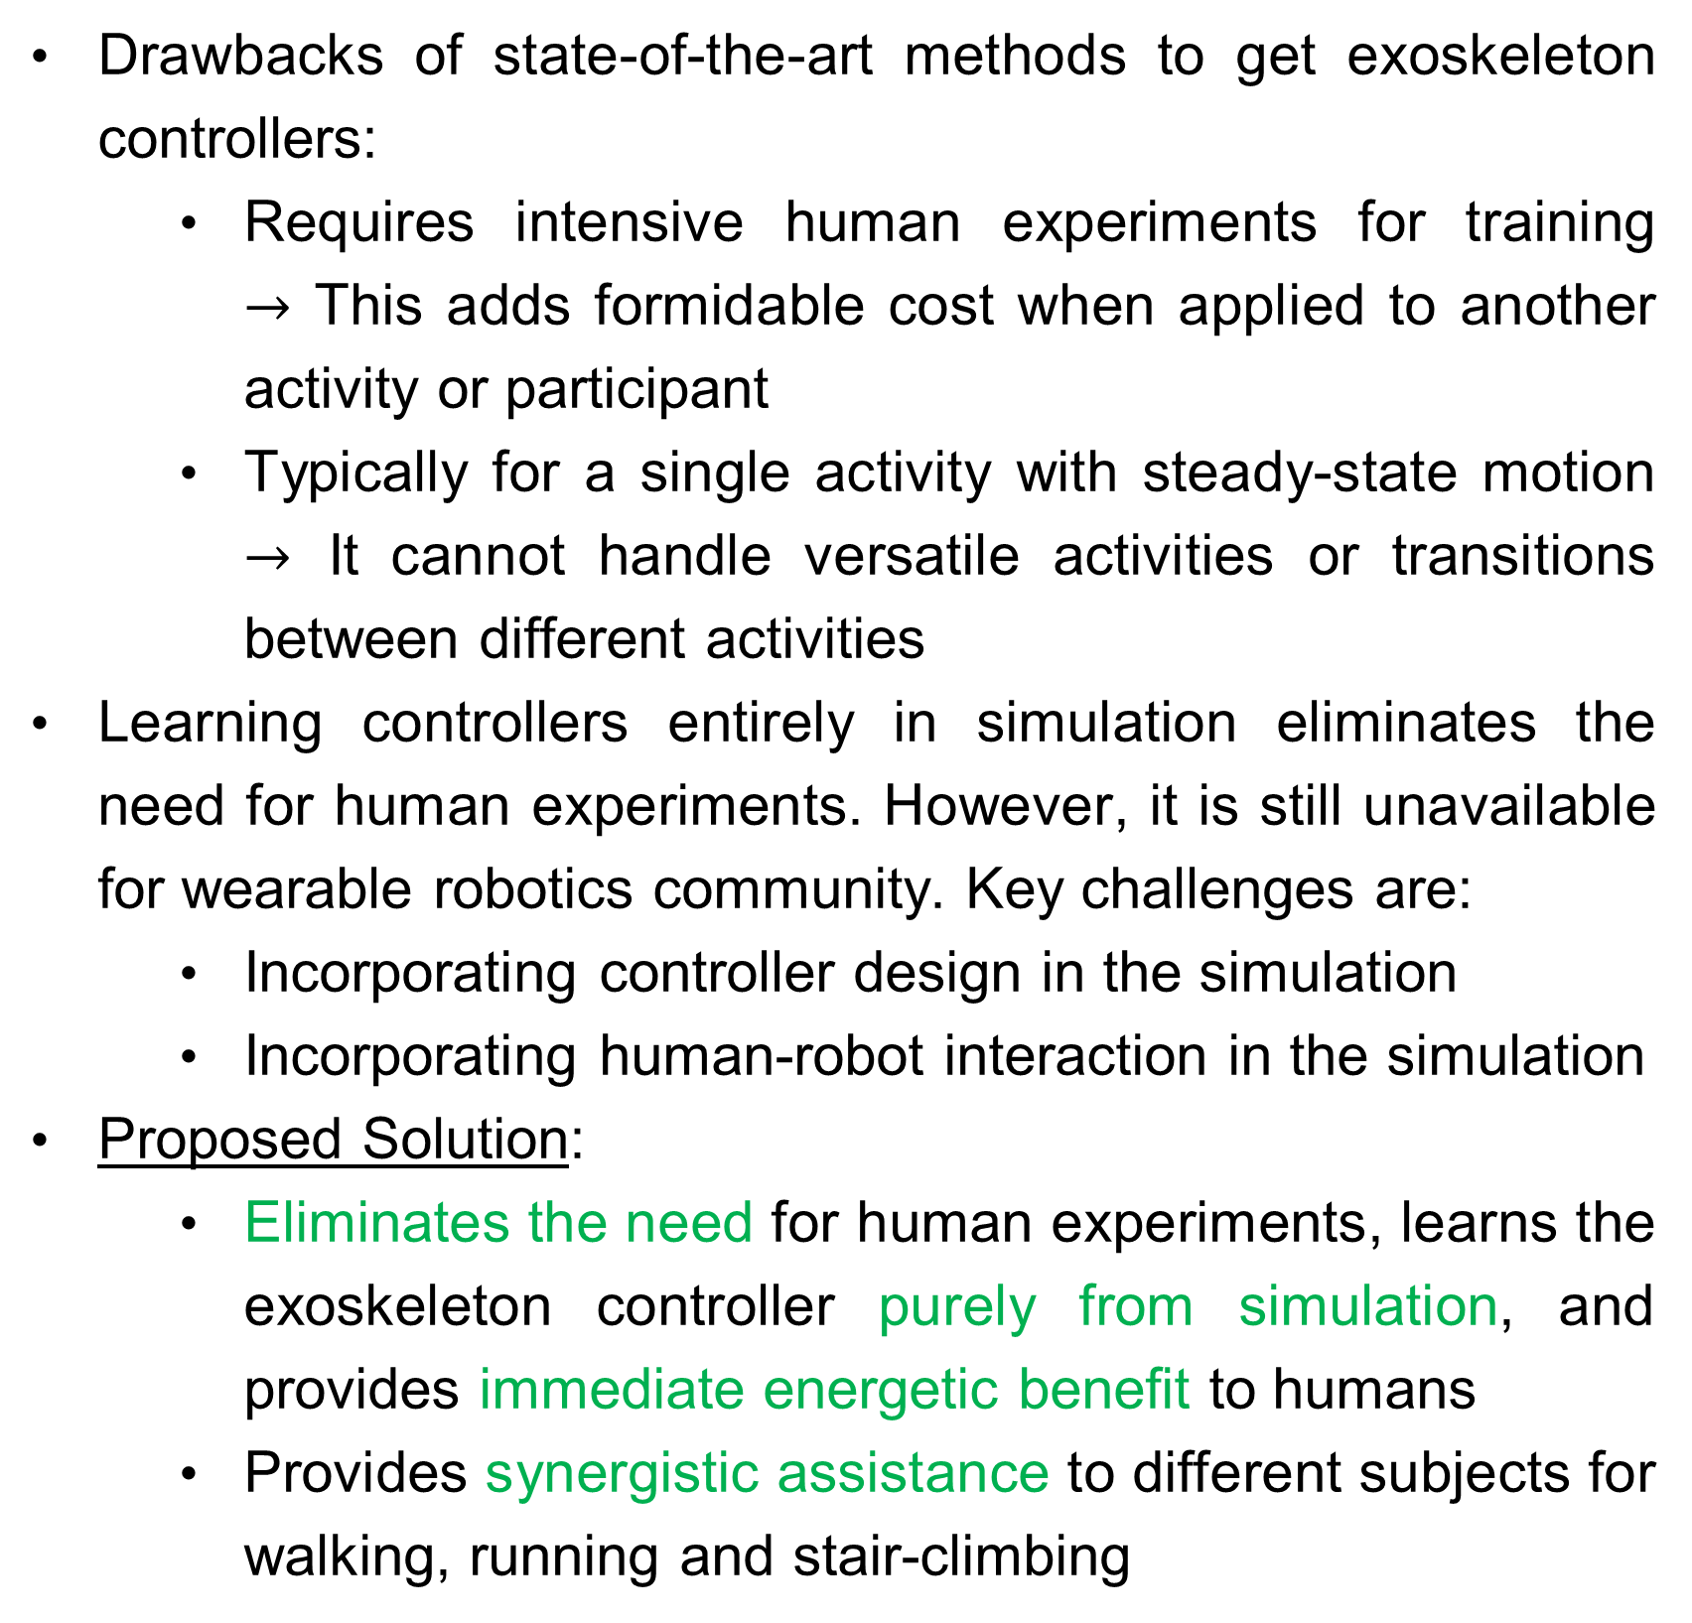
Learning in Simulation for Autonomous Control of
Wearable Robots, and Surgical Robots
This work is supported by the National Science Foundation grant
CAREER (CMMI 1944655)
NRI (1830613)
Future of Work (2026622)
Weibo Gao¹, Junxi Zhu¹, Menghan Jiang¹, Sainan Zhang¹, Ivan Lopez¹, Patrick Codd^{3,4} and Hao Su^{1,2∗}
This work is also supported by the NIDILRR grant 90DPGE0019
¹Biomechatronics and Intelligent Robotics lab, Department of Mechanical and Aerospace Engineering, North Carolina State University
²Joint NCSU/UNC Department of Biomedical Engineering, North Carolina State University, Raleigh, NC, 27695; University of North Carolina at Chapel Hill
³Department of Mechanical Engineering and Materials Science, Duke University
⁴Department of Neurosurgery, Duke University School of Medicine
Weibo Gao
Junxi Zhu
Menghan
Jiang
Sainan
Zhang
Ivan Lopez
Hao Su
Objectives and Challenges
Experiment-free Learning of Exoskeleton
Controller In Simulation
Significant Energetic Cost Reductions
on Versatile Activities
Opportunity: Snake-like Robot for Microsurgery
Wearable robots like lower-limb exoskeletons have great potential for mobility restoration and human augmentation
Challenge 1: Required intensive human testing
Challenge 2: Required handcrafted control laws
8 human subject (5 males, 3 females) experiments utilizing a lightweight, untethered and compliant hip exoskeleton
Reduced significant metabolic cost by 24.3% for walking, 15.2% for running, and 14.5% for stair climbing
Provides smooth transitions between different activities
Small cavity surgery needs small robot with superb dexterity
Drawbacks of state-of-the-art methods to get exoskeleton controllers:
Requires intensive human experiments for training $→$ This adds formidable cost when applied to another activity or participant
Typically for a single activity with steady-state motion $→$ It cannot handle versatile activities or transitions between different activities
Learning controllers entirely in simulation eliminates the need for human experiments. However, it is still unavailable for wearable robotics community. Key challenges are:
Incorporating controller design in the simulation
Incorporating human-robot interaction in the simulation
Proposed Solution:
Eliminates the need for human experiments, learns the exoskeleton controller purely from simulation, and provides immediate energetic benefit to humans
Provides synergistic assistance to different subjects for walking, running and stair-climbing
Designing Lightweight and High Torque Soft Exoskeletons
Ultra-Steerability Enables Dexterity in Small Cavities
Concentric tube robot: large radius, small angle
Our robot: small radius, large angle
Less invasive, less risk, improved patient care
Accelerate Development of Surgical Robots
via Learning in Simulation
[8]
Portable Mechatronics Architecture
Robot development requires intensive human tests: digital clinical trial?
Accelerate translation of AI-powered control into surgical procedures
High fidelity digital twins of human and devices
Sim2Real transfer learning
Physics-informed And Data-driven
Reinforcement Learning
Powerful control electronics architecture using a hierarchical structure with a high-level computer and a low-level microcontroller
System Control Architecture
References
Quasi Direct Drive Actuation Paradigm
Physics-informed modeling and data-driven learning:
Physics-informed modeling of human musculoskeletal dynamics, exoskeleton, and human-robot interaction
Data-driven learning through publicly available human kinematic motion capture dataset
Three networks are trained simultaneously in co-evolution:
Motion imitation network
Muscle coordination network
Exoskeleton control network
Dynamics randomization was used to facilitate Sim-to-real transfer of the trained control policy
Able to run complex control algorithms and improve speed, accuracy, and efficiency of exoskeleton’s control system, leading to better performance, user comfort, and safety
[1] S. Luo, M. Jiang, S. Zhang, J. Zhu, S. Yu, I. Dominguez Silva, T. Wang, E. Rouse, B. Zhou, H. Yuk, X. Zhou, and H. Su, “Experiment-free exoskeleton assistance via learning in simulation,” Nature, vol. 630, no. 8016, pp. 353–359, Jun. 2024. (This work)
[2] Luo, Shuzhen, et al. "Robust Walking Control of a Lower Limb Rehabilitation Exoskeleton Coupled with a Musculoskeletal Model via Deep Reinforcement Learning." Journal of neuroengineering and rehabilitation (2023).
[3] H. Su, ... & G. S. Fischer, (2014). Piezoelectrically actuated robotic system for MRI-guided prostate percutaneous therapy. IEEE/ASME transactions on mechatronics, 20(4), 1920-1932.
[4] H. Su, et al. "Physical human–robot interaction for clinical care in infectious environments." Nature Machine Intelligence 3.3 (2021): 184-186.
[5] Yu, Huang, Lynn, Sayd, Silivanov, Park, Tian, Su. Design and Control of a High-Torque and Highly-Backdrivable Hybrid Soft Exoskeleton for Knee Injury Prevention during Squatting. IEEE Robotics and Automation Letters, 2019
[6] Yu, Huang, Yang, Jiao, Yang, Chen, Yi, Su. Quasi-direct drive actuation for a lightweight hip exoskeleton with high backdrivability and high bandwidth. IEEE Transactions on Mechatronics, 2020. (Best student paper award)
[7] Huang, Zhang, Yu, MacLean, Zhu, Di Lallo, Jiao, Bulea, Zheng, & Su, Modeling and Stiffness-based Continuous Torque Control of Lightweight Quasi-Direct-Drive Knee Exoskeletons for Versatile Walking Assistance, IEEE Transactions on Robotics, 2022
[8] Zhu, Jiao, Dominguez, Yu and Su, "Design and Backdrivability Modeling of a Portable High Torque Robotic Knee Prosthesis With Intrinsic Compliance for Agile Activities," in IEEE/ASME Transactions on Mechatronics, vol. 27, no. 4, pp. 1837-1845, Aug. 2022 (2022 Best Paper in Mechatronics Award)
[9] Slade, Kochenderfer, Delp and Collins. Personalizing exoskeleton assistance while walking in the real world. Nature 610, 277-282 (2022).
[10] H. Su, K. Kwok, K. Cleary, J. Desai, I. Iordachita, C. Cavusoglu, G.S. Fischer, "State of the Art and Future Opportunities in MRI-Guided Robot-Assisted Surgery and Interventions," in Proceedings of the IEEE, vol. 110, no. 7, pp. 968-992, Jul. 2022
Notes:
a

